Slide 1
banana
SHOW

Slide 2
pizza
SHOW

Slide 3
soup
SHOW

Slide 4
popcorn
SHOW

Slide 5
juice
SHOW

Slide 6
broccoli
SHOW

Slide 7
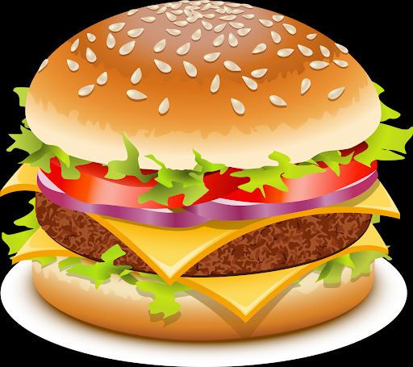
hamburger
SHOW

Slide 8
doughnut
SHOW

Slide 9
water
SHOW

